Slide 1
Centralized Configuration and Service Registry/Discovery with Spring Boot
Bharath and Vinod
June 16, 2020

Slide 2
Introduction
Why Microservices ?
Smaller and independent services
Autonomous processes and communicate through APIs
Scaling configuration based on needs/demands of each service
Each service can be implemented in different language
Scales by distributing services as needed across multiple machines
Notes:
“Microservices appropriate if starting from scratch.” – I would disagree, microservices are appropriate when you have deep enough knowledge of domain to understand service boundaries, it is usually achieved for greenfield pojects when starting with monolithic arch, learn domain and then migrate to microservices – the trick is not to wait too long

Slide 3
Microservices – Benefits and Challenges
Benefits
Challenges
Independent deployments
Independent development
Small, focused teams
Fault isolation
follow resiliency best practices and design patterns
Mixed technology stacks
Granular scaling
Services can be scaled independently
Complexity
Many moving parts
Development and test
Identify service boundaries
test service dependencies
Lack of governance
project-wide standards
Network congestion and latency
Inter-service communication
additional latency if chain of service dependencies gets too long
overly chatty APIs - favor asynchronous communication patterns
Data integrity
eventual consistency
Management
Mature DevOps culture
Configuration Management
Versioning
Multiple services could be updated at any given time
backward and forward compatibility
Team Skillset
Source: Microservices architecture style

Slide 4
Microservices Architecture
A popular architectural style for building applications that are resilient, highly scalable, independently deployable, and able to evolve quickly.
Consists of a collection of small, autonomous services. Each service is self-contained and should implement a single business capability.
Source: Microservices architecture style

Slide 5
Config Server with Spring Boot
Spring Cloud Config Server
Serving Alternative Formats
Serving Plain Text
Embedding the Config Server
Push Notifications and Spring Cloud Bus
Spring Cloud Config Client

Slide 6
Spring Cloud Config Server
Types of Repositories
Sample Spring Boot Config Server Application and Using GIT as Backend
Enabling Security
Encryption and Decryption, Key Management, Using Key Store for Encryption/Decryption, Key Rotation
Serving Encrypted Properties

Slide 7
Types of Repositories
Git Backend
Version Control Filesystem (SVN)
Vault Backend
JDBC Backend
Radis Backend
AWS S3 Backend
CredHub Backend
Composite Environment

Slide 8
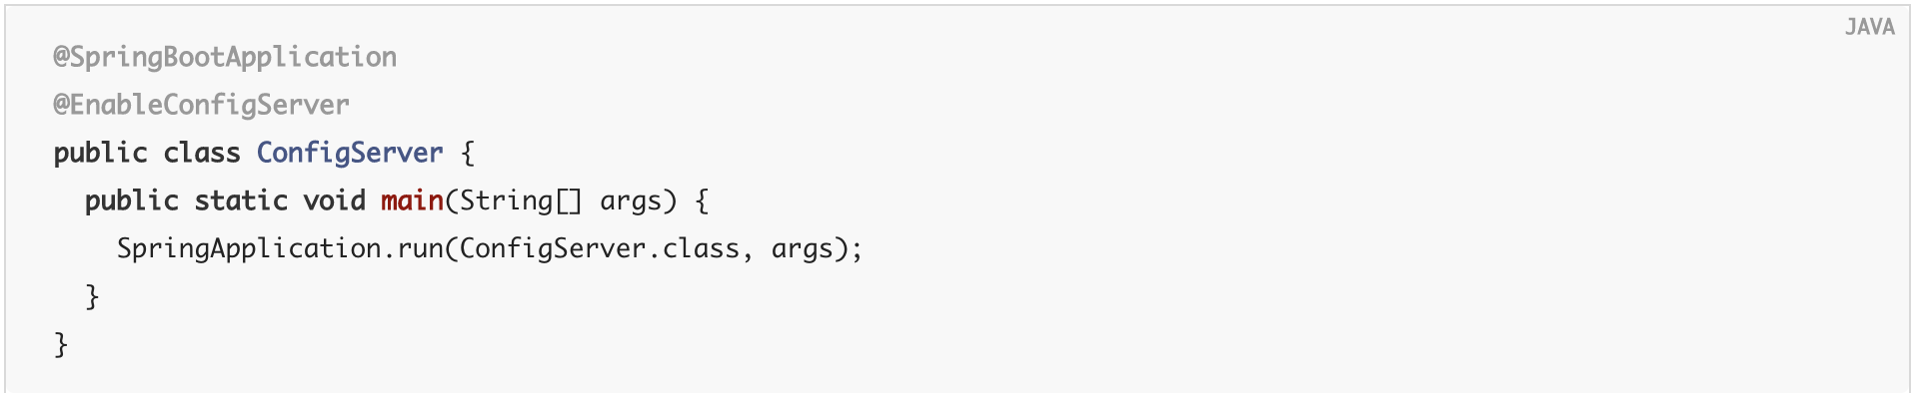
Sample Spring Boot Config Server Application

Slide 9
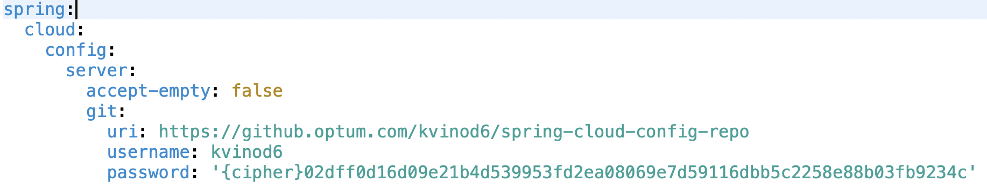
Git as Backend

Slide 10
Git as Backend
Sprint servers the application properties on “/{application}/{profile}/{label}” url.
{application} – spring.application.name
{profile} – spring.profiles.active
{label} – spring.cloud.config.label - default to master
Resolving Strategy:
application.properties/.yml – generic to all applications and profiles
application-{profile}.properties/.yml – generic to all application in a profile
{application}-{profile}.properties/.yml – specific to an application with a profile.
Ex: http://localhost:8888/hie-config-server/clientapp1/dev/master/

Slide 11
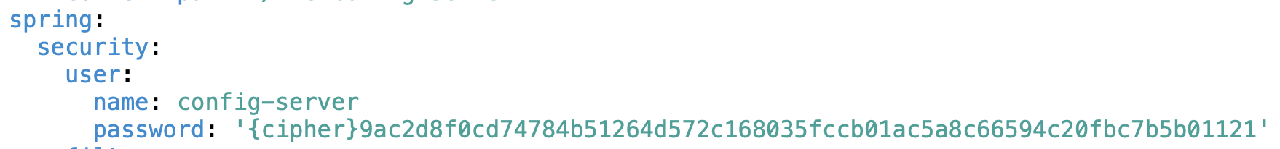
Enable Security

Slide 12
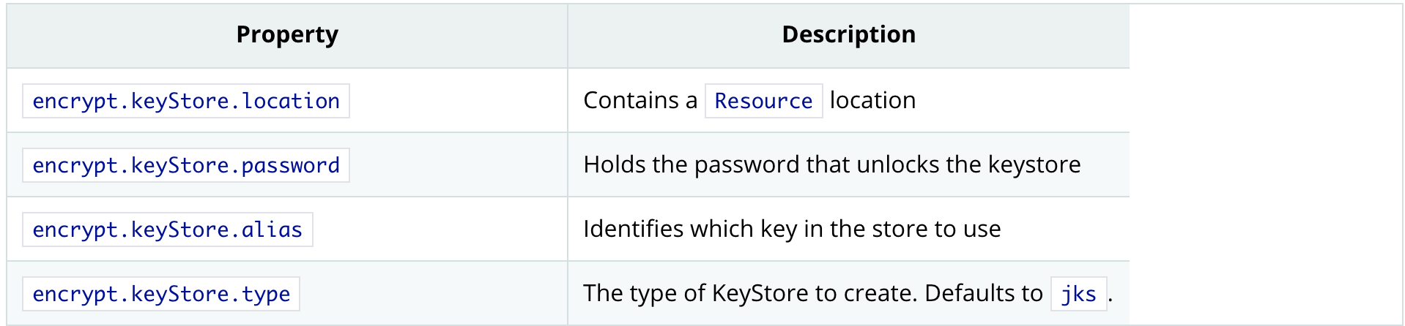
Encryption and Decryption
/encrypt and /decrypt endpoint helps in encrypt/decrypt the properties.
Ex: '{cipher}FKSAJDFGYOS8F7GLHAKERGFHLSAJ’
encryption and decryption depends on “encrypt.key” property (symmetric) or RSA key pair (asymmetric).
Encrypted properties are safely decrypted before delivering it to client.
If any {cypher} is not descrypted, those properties will be removed before serving the request to prevent cipher text being used as a password and accidentally leaking.
Supports multiple key rotation modal for better security. – (https://cloud.spring.io/spring-cloud-config/reference/html/#_using_multiple_keys_and_key_rotation)

Slide 13
Serving Encrypted Properties
We can also serve encrypted properties directly to client to decrypt them at client apps.
“spring.cloud.config.server.encrypt.enabled=false”
We can still we /encrypt and /decrypt endpoints.

Slide 14
Serving Alternative Formats
Spring Config Server has capability to deliver the properties in different formats.
Supported formats are:
JSON - Default
YML or YAML
.properties

Slide 15
Service Plain Text
Spring config server has capability to serve plain text files like log4j2.yml.
Sprint servers these files on “/{application}/{profile}/{label}/{path}”
{application} – spring.application.name
{profile} – spring.profiles.active
{label} – Git branch name – default to master
{path} – path to file. Ex: log4j2.yml
Ex: http://localhost:8888/hie-config-server/clientapp2/dev/master/log4j2.yml
Spring placeholders are supported in plain text files:
http://localhost:8888/hie-config-server/eureka/int/master/nginx.conf
http://localhost:8888/hie-config-server/clientapp2/int/master/nginx.conf
Encryption is not enabled for plain text files by default. We can enabled by adding
spring.cloud.config.server.encrypt.plainTextEncrypt=true in bootstrap.[yml|properties]

Slide 16
Embedding Config Server
Spring config server works better as standalone – As per the spring docs.
Still we can embed our config server along with any spring boot application – Not recommended.
Reference: https://cloud.spring.io/spring-cloud-config/reference/html/#_embedding_the_config_server

Slide 17
Push Notifications and Spring Cloud Bus
Github uses a POST to the webhook with a JSON body containing a list of commits and a header (X-Github-Event) set to push.
/monitor endpoint can be enabled on Spring Boot Config Server by adding “spring-cloud-config-monitor” dependency.
A “RefreshRemoteApplicationEvent” will be triggered at targeted application based on the files changed.
clientapp2.properties targets to client-app-2 app
application.properties targets to all applications.
A manual trigger on “/monitor” endpoint with form-encoded body parameters in the pattern of path={application}
Ex: POST /monitor
Body path=clientapp* - Wildcard characters are allowed.

Slide 18
Spring Cloud Config Client
Sample Implementations:
Client App1: https://github.optum.com/kvinod6/spring-cloud-poc/tree/master/spring-cloud-client-app1
Client App2: https://github.optum.com/kvinod6/spring-cloud-poc/tree/master/spring-cloud-client-app2

Slide 19
Service Registry with Eureka
Eureka is a REST (Representational State Transfer) based service that is primarily used for locating services.
It enables client-side load-balancing and decouples service providers from consumers without the need for DNS.
https://github.optum.com/kvinod6/spring-cloud-poc/tree/master/spring-cloud-eureka-server-app

Slide 20
Proxy Config with Zuul
Zuul is the front door for all requests from devices and web sites to the backend services.
Zuul uses a range of different types of filters that enables us to quickly and nimbly apply functionality to our edge service.
Authentication and Security - identifying authentication requirements for each resource and rejecting requests that do not satisfy them.
Insights and Monitoring - tracking meaningful data and statistics at the edge in order to give us an accurate view of production.
Dynamic Routing - dynamically routing requests to different backend clusters as needed.
Stress Testing - gradually increasing the traffic to a cluster in order to gauge performance.
Load Shedding - allocating capacity for each type of request and dropping requests that go over the limit.
Static Response handling - building some responses directly at the edge instead of forwarding them to an internal cluster.
Multiregion Resiliency - routing requests across different regions in order to diversify our ELB usage and move our edge closer to our members.
Sample Application: https://github.optum.com/kvinod6/spring-cloud-poc/tree/master/spring-cloud-zuul-app

Slide 21
Spring POC GIT Repos
Sample Config Server App: https://github.optum.com/kvinod6/spring-cloud-poc/tree/master/spring-cloud-config-app
Sample Config Git Repos:
Dev: https://github.optum.com/kvinod6/spring-cloud-config-repo
XAAS: https://github.optum.com/kvinod6/spring-cloud-config-repo-xass
Non Prod: https://github.optum.com/kvinod6/spring-cloud-config-repo-stage
Prod: https://github.optum.com/kvinod6/spring-cloud-config-repo-production

Slide 22
References
* Spring Config Server * Service Registry (Eureka) * Load Balancing with Zuul

